Slide 1
Audio Amplifier
Rahul Kashyap - 2018102037
Avinash Prabhu - 2018102027

Slide 2
Block Diagram
Microphone
Pre-amplifier
Gain Stage
Volume Control
Load
Power Amplifier
Filter

Slide 3
Microphone and Pre-Amplifier
A microphone is used to convert sound signals to analog electronic signals.
The pre-amplifier is used to convert a weak electric signal into a strong electric signal.
It is used to remove noise and be strong enough for further processing.
If this stage is not implemented the final signal could be noisy and distorted.
We will use a differential amplifier .

Slide 4
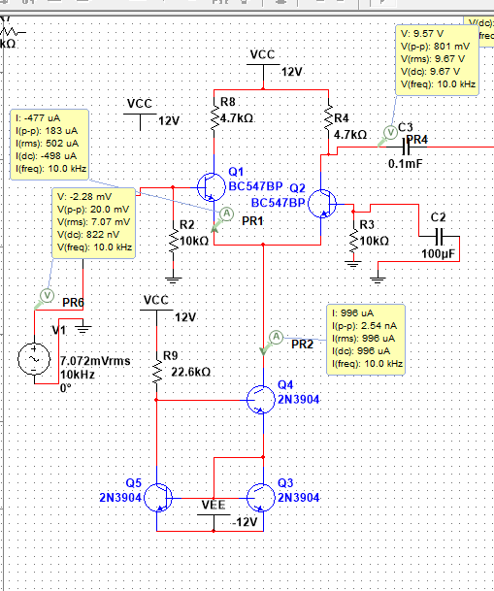
Impedance and gain for proposed design:
Gain for Preamp stage is 40 V/V.
Gain = Rc/re
Rc - 4.7k ohms re= 50-100 ohms
Use of current mirror : small change in voltage doesn’t affect values of re and gain.

Slide 5
Gain Stage
This stage is used to meet the overall gain specifications.
We plan to use a basic common emitter for this gain stage.
To ensure no loading on the previous stages we used common emitter in the gain stage which produces gain with high input impedance.

Slide 6
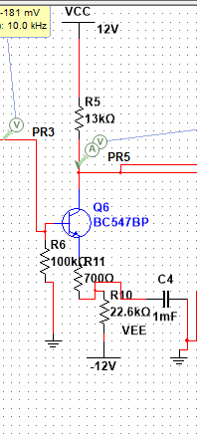
Gain Stage using Common Emitter
Gain = Rc/(re+Re)
Obtained gain 16.25v/v.
Rc = 13K
Re = 700
re = 50-100

Slide 7
Filter
A filter is used to make sure that the output signal is the audio frequency range.
We will use a bandpass filter to only to pass frequencies between 20 Hz and 20 KHz.
It is designed by cascading a active high pass filter with a low pass filter interlinked by a amplifying component.

Slide 8
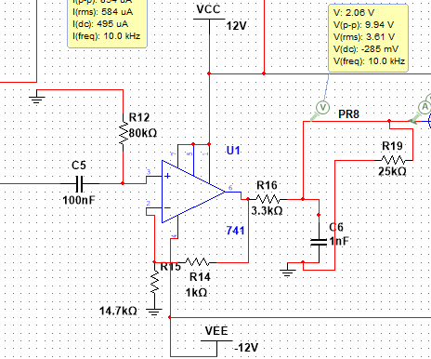
Bandpass Filter
A passive filter gain is never greater than unity and loading may take place, so we use a active filter to control the loss of signal.

Slide 9
Power Amplifier
The power amplifier is used to increase the power of the input signal so that it is strong enough to drive the loads of the output resistances.
Here, we will be using a Class AB output stage as it overcomes a lot of the problems with Class A and B output stages.
Power amplifier is able to draw high currents from the source and can sustain where as other transistors can blow out.

Slide 10
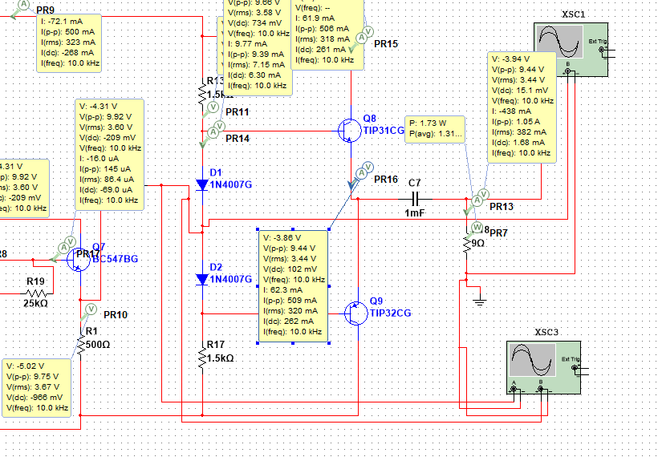
Power Amplifier using Class AB
Description:
Power amplifier which gives a power of 1.5W across the speaker which is required for a speaker to turn on and produce the sound.

Slide 11
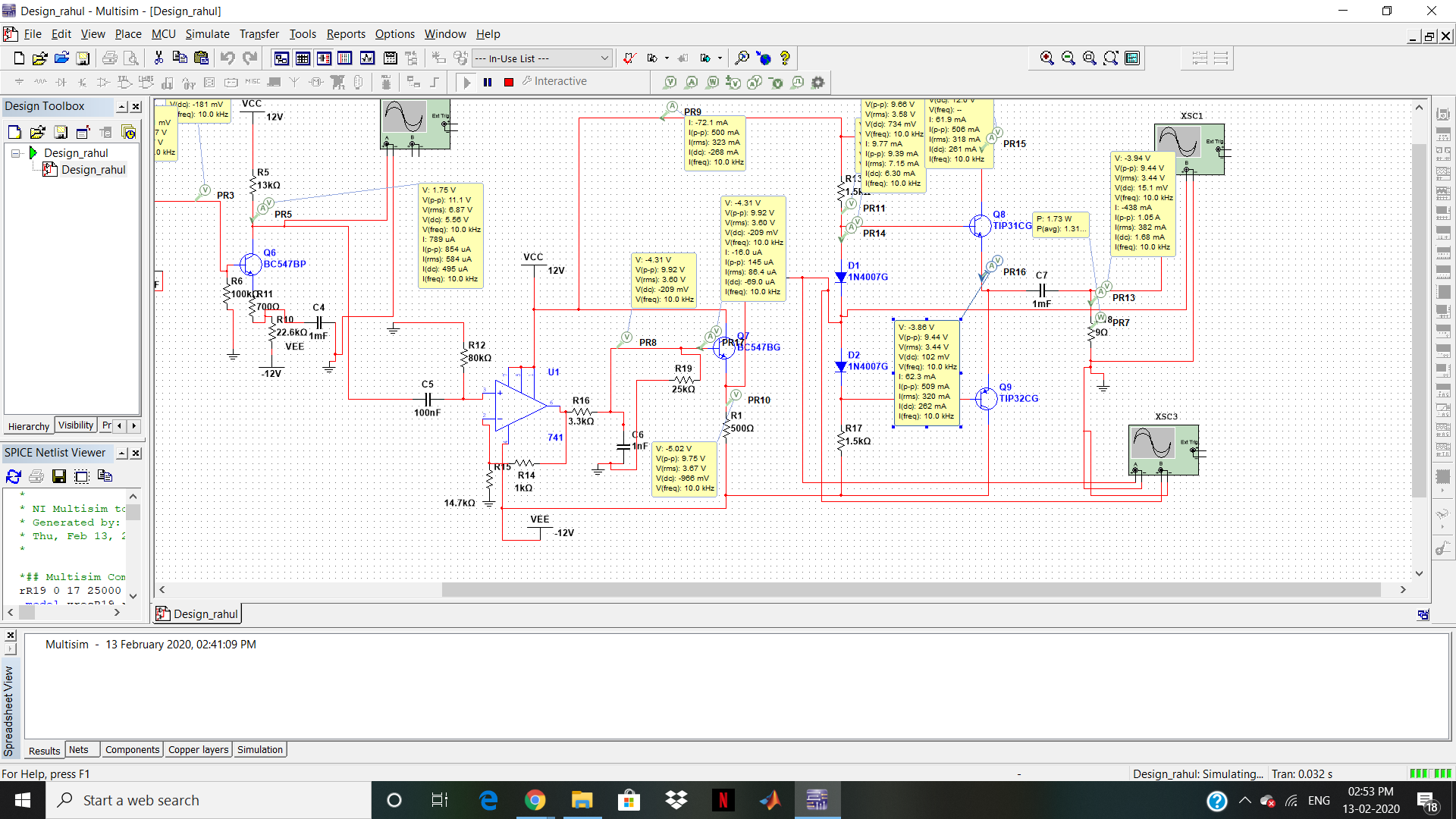
The entire design

Slide 12

Thank You!!

